Slide 1
IST707
Dhwani Gandhi
Karan Ashar

Slide 2

People’s Analytics
Problem Statement
Help Predict if a person would continue working in the company after training or not

Slide 3

Understanding the Problem Statement
What is the problem?
How will solving this problem benefit the company?

Slide 4
Answers
The company offers training to individuals which would help them be successful in the field of data
The main objective of the company is to train these individuals and hire them once they are up to the company standards
After putting all the hours to train the individuals, the company observed that many of them go and work for some other company
This is a loss for the company. They are training the individuals and someone else is reaping the benefits

Slide 5
Continued…
They do not want this to happen. They want to retain the talent they train
Retaining the talent proves to be more profitable to the company
Predicting the outcome would help the company train selective individuals which would stay after the training to benefit the company

Slide 6
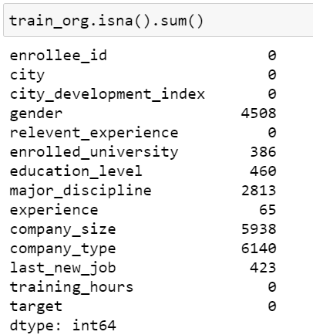
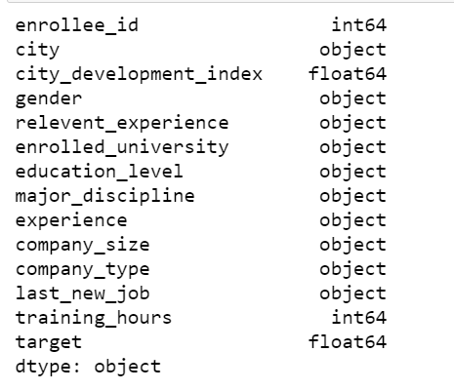
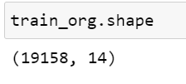
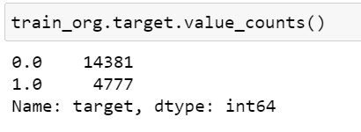
Describing the Data

Slide 7
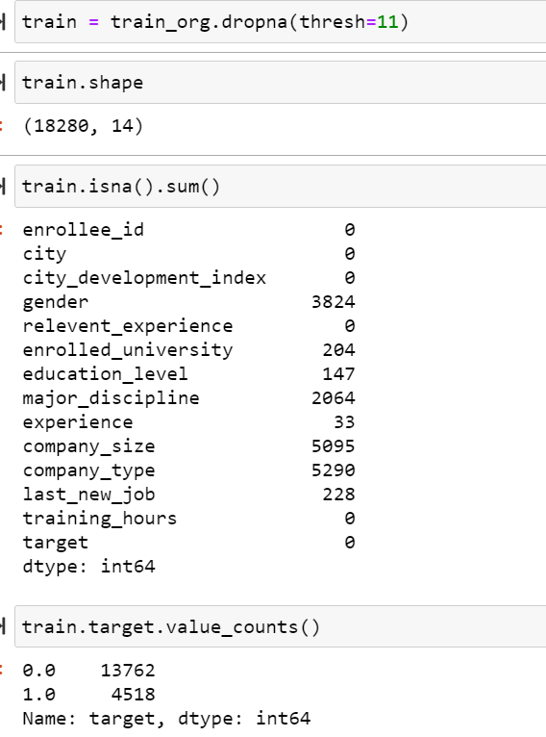
Data Pre-Processing
Dealing with NA
We drop all the rows containing more than 3 NA
We fill the remaining with ‘Unknown’

Slide 8
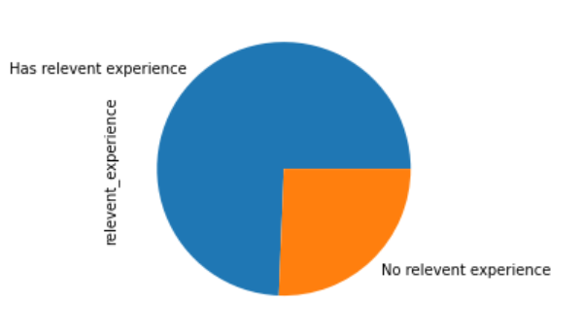
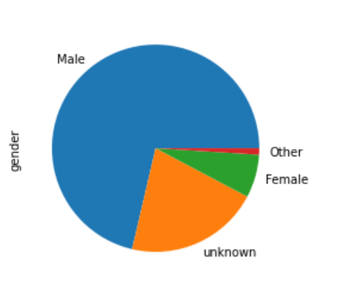
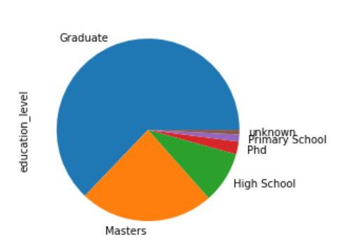
Data Visualizations

Slide 9
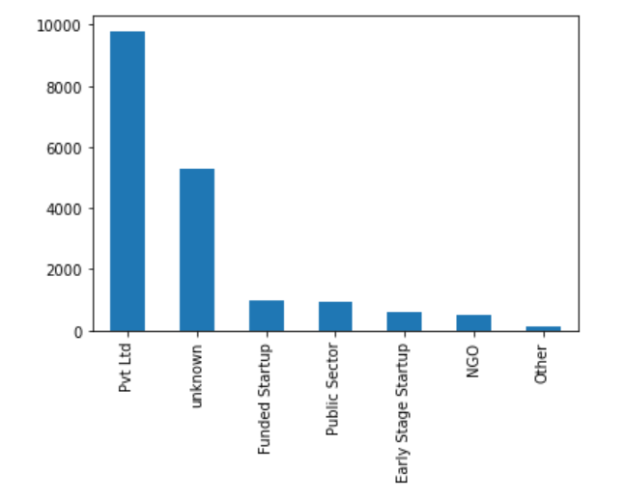
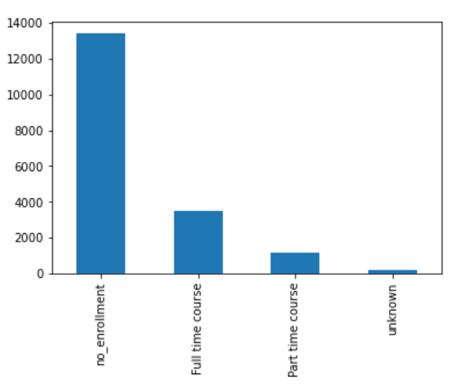

Slide 10
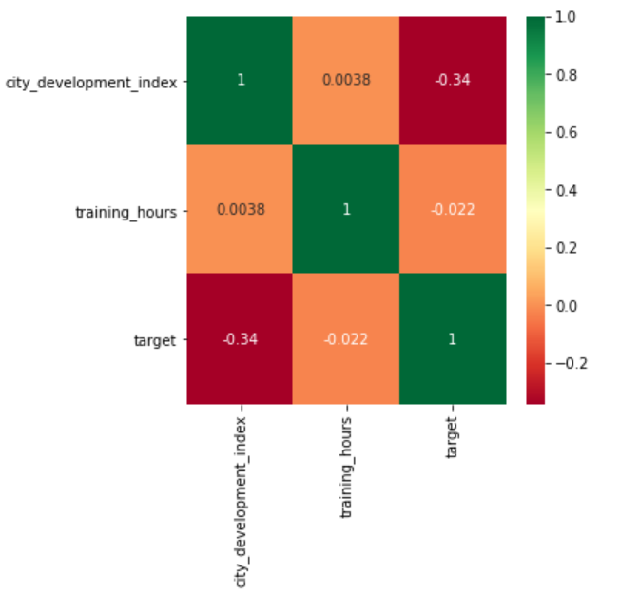
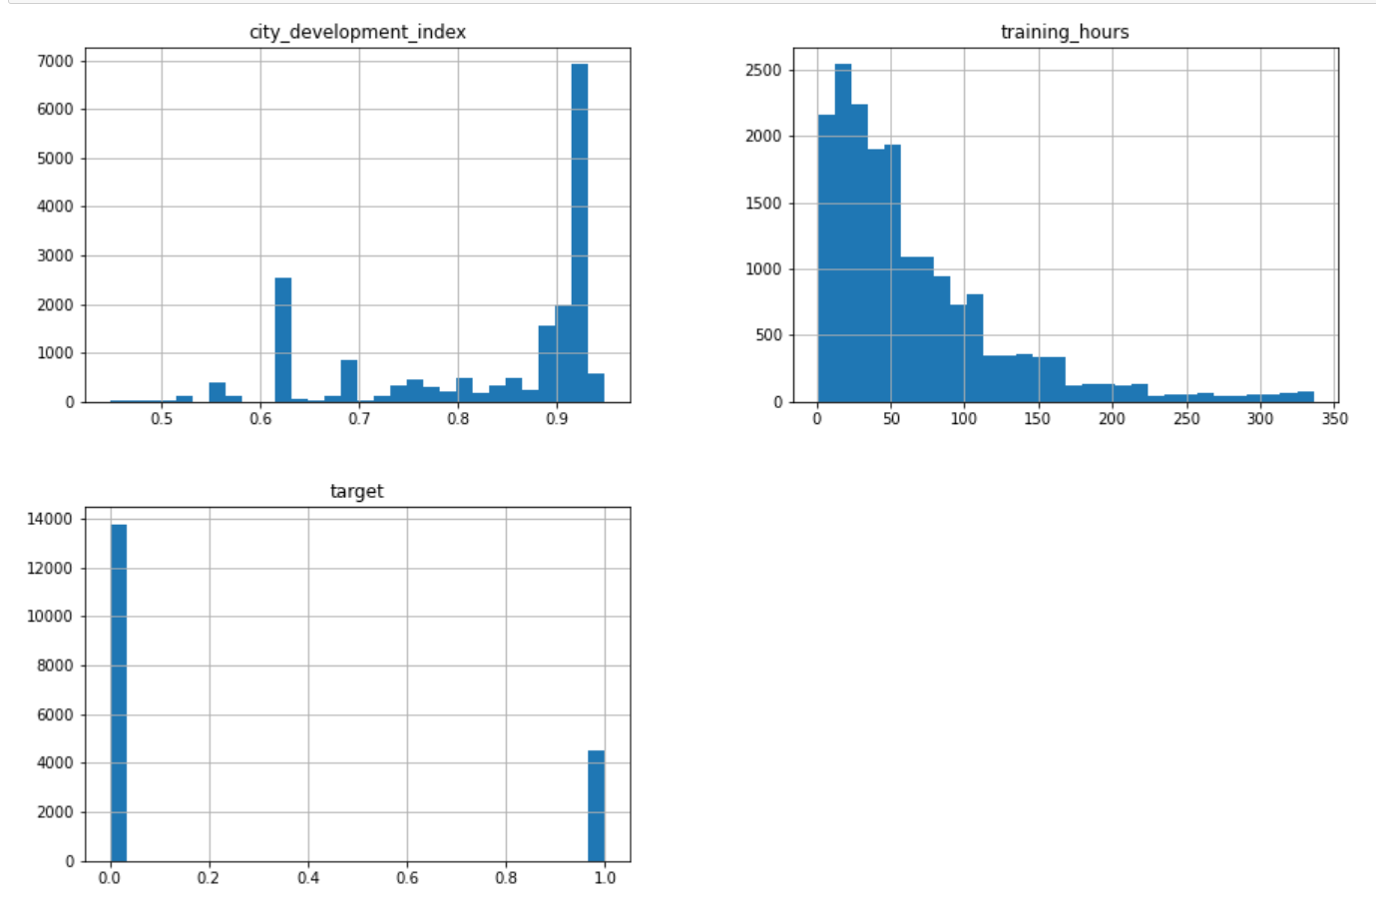

Slide 11
Data Processing
Feature Scaling
The numeric features were scaled using a MinMax() scaler
Encoding
The categorical features were converted to dummy variables

Slide 12
High Cardinality – City
The column ‘city’ has high cardinality
There are 126 unique values in the column
We solve this problem using PCA
We preserved 85% of the variance explained by these 126 columns by using only 33 components

Slide 13
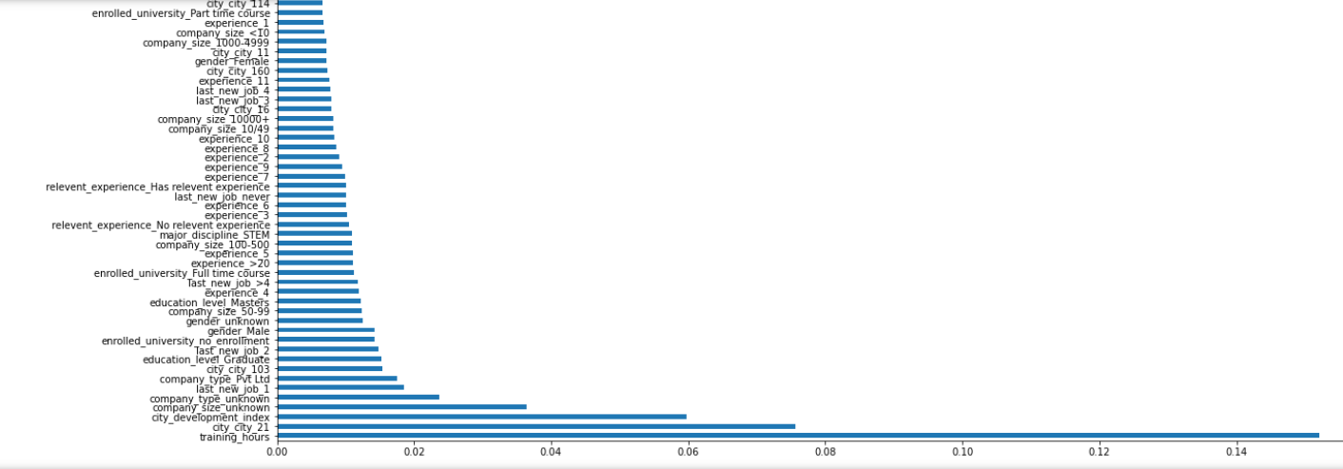
Feature Selection and Feature Importance
Extra Trees Classifier was used to predict top features
The chart below represents the top features of the entire dataset(without PCA)

Slide 14
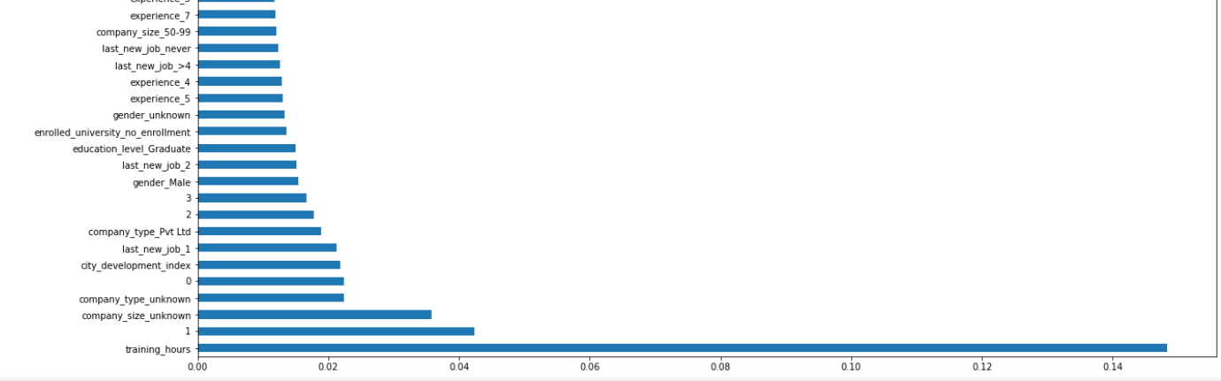
Below is the chart which consists of the top
features after PCA

Slide 15
Predictive Modeling
The following Machine Learning Models were used:
Logistic Regression
Random Forest
Support Vector Machine
Gradient Boosting Tree

Slide 16
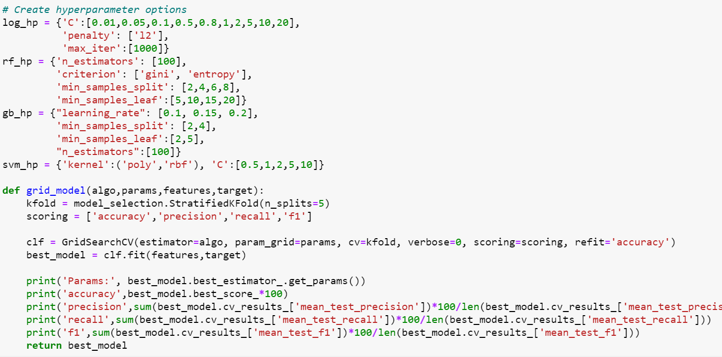
Predictive Modeling
Default models for the dataset with PCA
Default models for the dataset with PCA including only top 50 features
Hyperparameter Tuning

Slide 17
Results from individual models
Model | Precision- Class 0 | Accuracy | Log Loss | Area Under ROC
Logistic Regression | 0.82 | 0.79 | 0.45 | 0.65
Random Forest | 0.85 | 0.79 | 0.44 | 0.71
Gradient Boost | 0.85 | 0.80 | 0.43 | 0.71
Support Vector Machine | 0.85 | 0.79 | 0.46 | 0.70

Slide 18
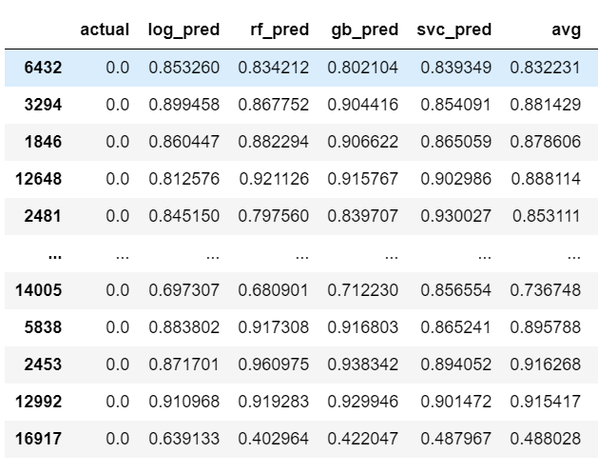
Ensemble Model

Slide 19
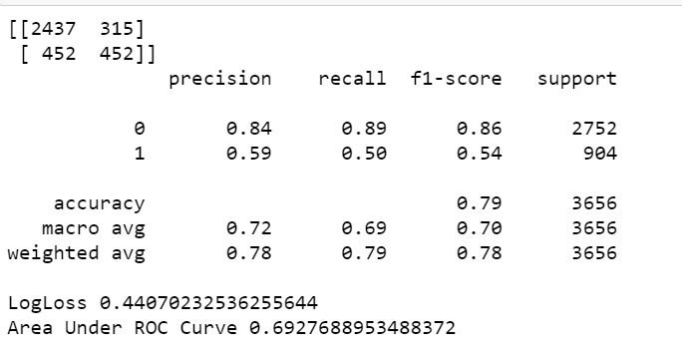
Ensemble Model – 0.5 Threshold

Slide 20
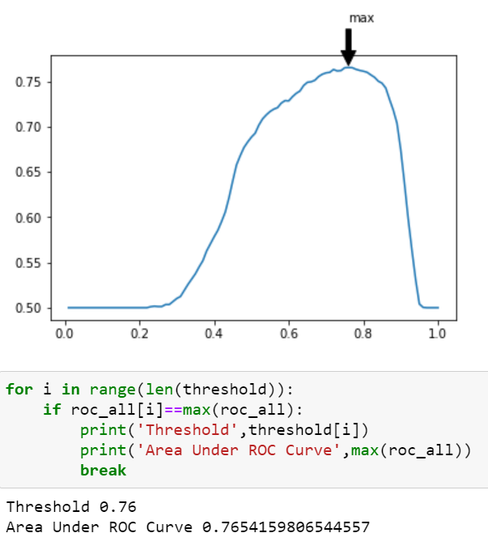
Finding Optimum Threshold – Area Under ROC

Slide 21
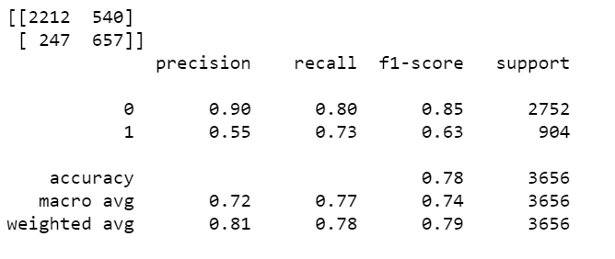
Ensemble Model – Optimum Threshold

Slide 22
Thank you!

